Slide 1
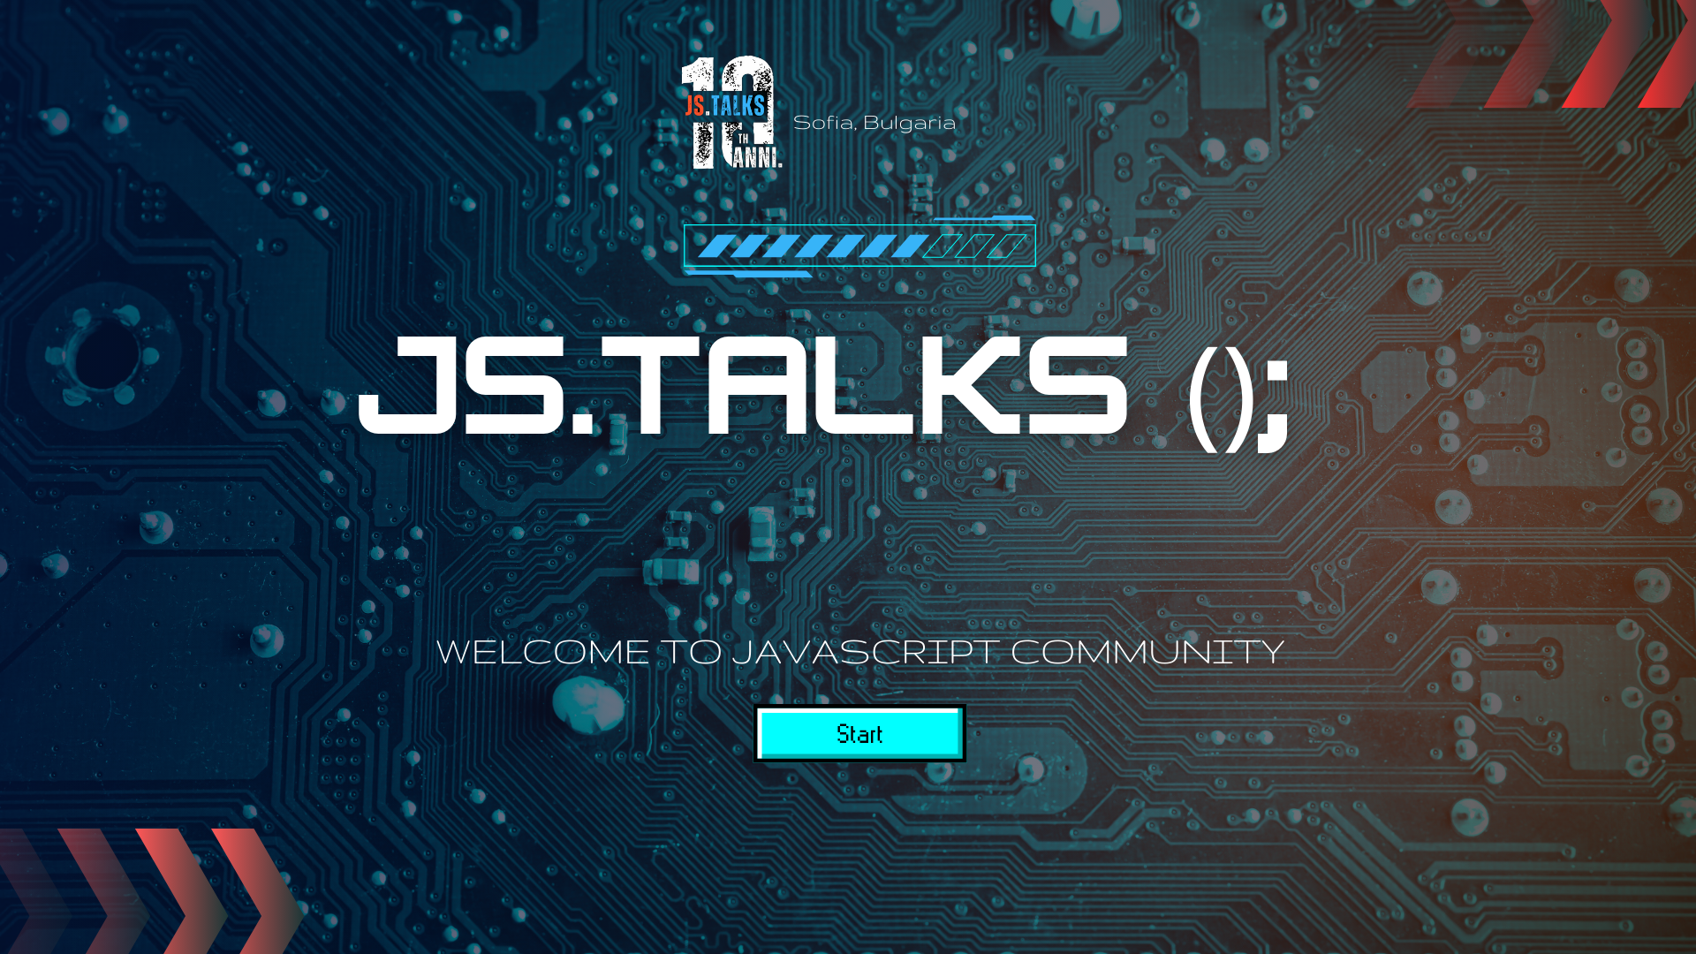

Slide 2




22-23 November 2024
Kiril Zhelyazkov
Front-end Developer
SiteGround
Passion for learning
Road trips with a Yamaha T700
Bulgarian Folklore Dance Classes
Sofia, Bulgaria
https://www.jstalks.net/
Notes:
Working in SiteGround has brought to me …
Shate what is valuable for you
Човека зад програмиста

Slide 3


22-23 November 2024
AGENDA
History of reactivity
Immutability
Valuecentric design
Practical and theoretical implementation
Sofia, Bulgaria
https://www.jstalks.net/
Notes:
Give the expectations
How these concepts came to be and are used together
Reason in a decoupled way

Slide 4
22-23 November 2024
Value Oriented Design
Sofia, Bulgaria
https://www.jstalks.net/
Notes:
Usually subjective

Slide 5
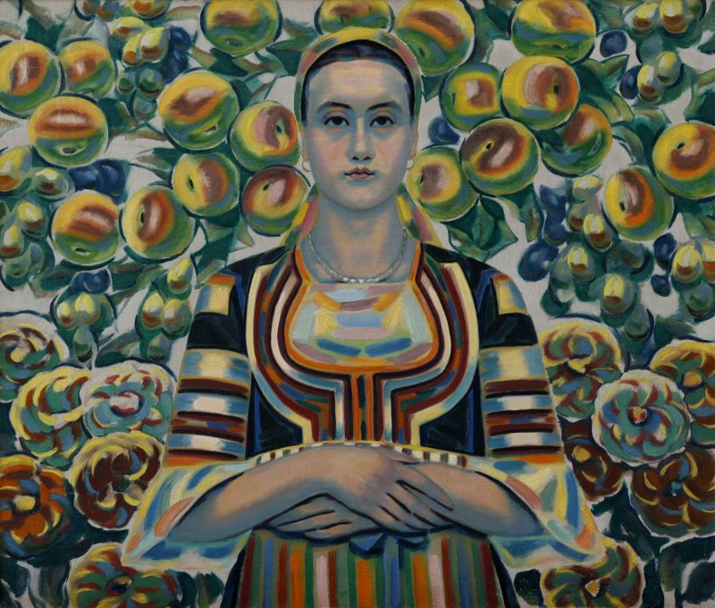
22-23 November 2024
Sofia, Bulgaria
https://www.jstalks.net/

Slide 6
22-23 November 2024
PROGRAMMING VALUES
const data = { value: 'Hello' };
Sofia, Bulgaria
https://www.jstalks.net/
Notes:
Value is space
Tends to change in the lifecycle of the application

Slide 7
jQuery(document).ready(function(){
/**
* This part handles the highlighting functionality.
*/
var aChildren = jQuery("aside.sub_cat_active ul li").children(); // find the a children of the list items
var aArray = []; // create the empty aArray
for (var i=0; i < aChildren.length; i++) {
var aChild = aChildren[i];
var ahref = jQuery(aChild).attr('href');
aArray.push(ahref);
} // this for loop fills the aArray with attribute href values
jQuery(window).scroll(function(e){
var windowPos = jQuery(window).scrollTop(); // get the offset of the window from the top of page
var windowHeight = jQuery(window).height(); // get the height of the window
var docHeight = jQuery(document).height();
for (var i=0; i < aArray.length; i++) {
var theID = aArray[i];
var divPos = jQuery(theID).offset().top + (-100); // get the offset of the div from the top of page
var divHeight = jQuery(theID).height(); // get the height of the div in question
if (windowPos >= divPos && windowPos < (divPos + divHeight)) {
jQuery("a[href='" + theID + "']").parent().addClass("aside-selected");
jQuery("a[href='" + theID + "']").addClass("selected-link");
if(isMobile.matches && window.location.href.indexOf(".php") > -1 ){
jQuery("body.subcat-page aside.sub_cat_active ul li .selected-link")[0].scrollIntoView( { inline: "center" } );
// jQuery("body.subcat-page aside.sub_cat_active ul li .selected-link")[0].scrollIntoView();
}
} else {
jQuery("a[href='" + theID + "']").parent().removeClass("aside-selected");
jQuery("a[href='" + theID + "']").removeClass("selected-link");
}
}
if(windowPos + windowHeight == docHeight) {
if (!jQuery("#v-nav ul li:last-child a").parent().hasClass("aside-selected")) {
var navActiveCurrent = jQuery(".aside-selected").children().attr("href");
jQuery("a[href='" + navActiveCurrent + "']").parent().removeClass("aside-selected");
jQuery("#v-nav ul li:last-child a").parent().addClass("aside-selected");
}
}
});
});
22-23 November 2024
Sofia, Bulgaria
https://www.jstalks.net/
Notes:
https://www.ozone.bg/landing/black-friday/js/scripts.js

Slide 8
jQuery(document).ready(function(){
/**
* This part handles the highlighting functionality.
*/
var aChildren = jQuery("aside.sub_cat_active ul li").children(); // find the a children of the list items
var aArray = []; // create the empty aArray
for (var i=0; i < aChildren.length; i++) {
var aChild = aChildren[i];
var ahref = jQuery(aChild).attr('href');
aArray.push(ahref);
} // this for loop fills the aArray with attribute href values
jQuery(window).scroll(function(e){
var windowPos = jQuery(window).scrollTop(); // get the offset of the window from the top of page
var windowHeight = jQuery(window).height(); // get the height of the window
var docHeight = jQuery(document).height();
for (var i=0; i < aArray.length; i++) {
var theID = aArray[i];
var divPos = jQuery(theID).offset().top + (-100); // get the offset of the div from the top of page
var divHeight = jQuery(theID).height(); // get the height of the div in question
if (windowPos >= divPos && windowPos < (divPos + divHeight)) {
jQuery("a[href='" + theID + "']").parent().addClass("aside-selected");
jQuery("a[href='" + theID + "']").addClass("selected-link");
if(isMobile.matches && window.location.href.indexOf(".php") > -1 ){
jQuery("body.subcat-page aside.sub_cat_active ul li .selected-link")[0].scrollIntoView( { inline: "center" } );
// jQuery("body.subcat-page aside.sub_cat_active ul li .selected-link")[0].scrollIntoView();
}
} else {
jQuery("a[href='" + theID + "']").parent().removeClass("aside-selected");
jQuery("a[href='" + theID + "']").removeClass("selected-link");
}
}
if(windowPos + windowHeight == docHeight) {
if (!jQuery("#v-nav ul li:last-child a").parent().hasClass("aside-selected")) {
var navActiveCurrent = jQuery(".aside-selected").children().attr("href");
jQuery("a[href='" + navActiveCurrent + "']").parent().removeClass("aside-selected");
jQuery("#v-nav ul li:last-child a").parent().addClass("aside-selected");
}
}
});
});
22-23 November 2024
Sofia, Bulgaria
https://www.jstalks.net/
Notes:
Тва като го видите какво си мислите
Ако го видите тоя код кво си викате

Slide 9
22-23 November 2024
jQuery(document).ready(function(){
/**
* This part handles the highlighting functionality.
*/
var aChildren = jQuery("aside.sub_cat_active ul li").children(); // find the a children of the list items
var aArray = []; // create the empty aArray
for (var i=0; i < aChildren.length; i++) {
var aChild = aChildren[i];
var ahref = jQuery(aChild).attr('href');
aArray.push(ahref);
} // this for loop fills the aArray with attribute href values
jQuery(window).scroll(function(e){
var windowPos = jQuery(window).scrollTop(); // get the offset of the window from the top of page
var windowHeight = jQuery(window).height(); // get the height of the window
var docHeight = jQuery(document).height();
for (var i=0; i < aArray.length; i++) {
var theID = aArray[i];
var divPos = jQuery(theID).offset().top + (-100); // get the offset of the div from the top of page
var divHeight = jQuery(theID).height(); // get the height of the div in question
if (windowPos >= divPos && windowPos < (divPos + divHeight)) {
jQuery("a[href='" + theID + "']").parent().addClass("aside-selected");
jQuery("a[href='" + theID + "']").addClass("selected-link");
if(isMobile.matches && window.location.href.indexOf(".php") > -1 ){
jQuery("body.subcat-page aside.sub_cat_active ul li .selected-link")[0].scrollIntoView( { inline: "center" } );
// jQuery("body.subcat-page aside.sub_cat_active ul li .selected-link")[0].scrollIntoView();
}
} else {
jQuery("a[href='" + theID + "']").parent().removeClass("aside-selected");
jQuery("a[href='" + theID + "']").removeClass("selected-link");
}
}
if(windowPos + windowHeight == docHeight) {
if (!jQuery("#v-nav ul li:last-child a").parent().hasClass("aside-selected")) {
var navActiveCurrent = jQuery(".aside-selected").children().attr("href");
jQuery("a[href='" + navActiveCurrent + "']").parent().removeClass("aside-selected");
jQuery("#v-nav ul li:last-child a").parent().addClass("aside-selected");
}
}
});
});
Sofia, Bulgaria
https://www.jstalks.net/
Notes:
We develop new ways of working when pressure occurs

Slide 10
22-23 November 2024
WHY IS IT COMPLICATED?
Sofia, Bulgaria
https://www.jstalks.net/
Notes:
You need a specific emission in time
Moving against the flow of execution

Slide 11
22-23 November 2024
TWO REASONS
Sofia, Bulgaria
https://www.jstalks.net/
Notes:
You need a specific emission in time
Moving against the flow of execution

Slide 12
22-23 November 2024
THE LANGUAGE DOES NOT PROTECT US
Sofia, Bulgaria
https://www.jstalks.net/

Slide 13
22-23 November 2024
IT USED TO BE SIMPLE
<p id="message">Hello, JS.Talks()!</p>
<button onclick="updateMessage()">Click Me</button>
<script>
function updateMessage() {
document.getElementById("message").textContent = "Hellow!";
}
</script>
Sofia, Bulgaria
https://www.jstalks.net/
Notes:
What problems was it designed to solve
when multiple things happen at once (like in modern apps or on the web), it gets messy because everyone is trying to "write" to the same chalkboard at the same time

Slide 14
22-23 November 2024
NOT A BYTE MORE
const data = { value: 'Hello' };
const content = document.createTextNode(data.value);
const paragraph = document.createElement('p');
paragraph.appendChild(content);
document.body.appendChild(paragraph);
// some place else in the code
data.value = 'Hello JS.Talks()';
Sofia, Bulgaria
https://www.jstalks.net/
Notes:
We go against the flow of execution
We mutate
Leads to unexpected behavior

Slide 15
22-23 November 2024
HOW TO MAKE IT PREDICTABLE?
const data = { value: 'Hello' };
const content = document.createTextNode(data.value);
const paragraph = document.createElement('p');
paragraph.appendChild(content);
document.body.appendChild(paragraph);
// some place else in the code
data.value = 'Hello JS.Talks()';
Sofia, Bulgaria
https://www.jstalks.net/

Slide 16
22-23 November 2024
How can we design modern applications to be more predictable and maintainable?
Sofia, Bulgaria
https://www.jstalks.net/
Notes:
Break away from the pop culture a bit and look at the foundations
Illuminate the principles of reactivity

Slide 17
22-23 November 2024
I DON’T KNOW…
Sofia, Bulgaria
https://www.jstalks.net/
Notes:
Break away from the pop culture a bit and look at the foundations
Illuminate the principles of reactivity

Slide 18
22-23 November 2024
I DON’T KNOW…
IT DEPENDS
Sofia, Bulgaria
https://www.jstalks.net/
Notes:
Break away from the pop culture a bit and look at the foundations
Illuminate the principles of reactivity

Slide 19
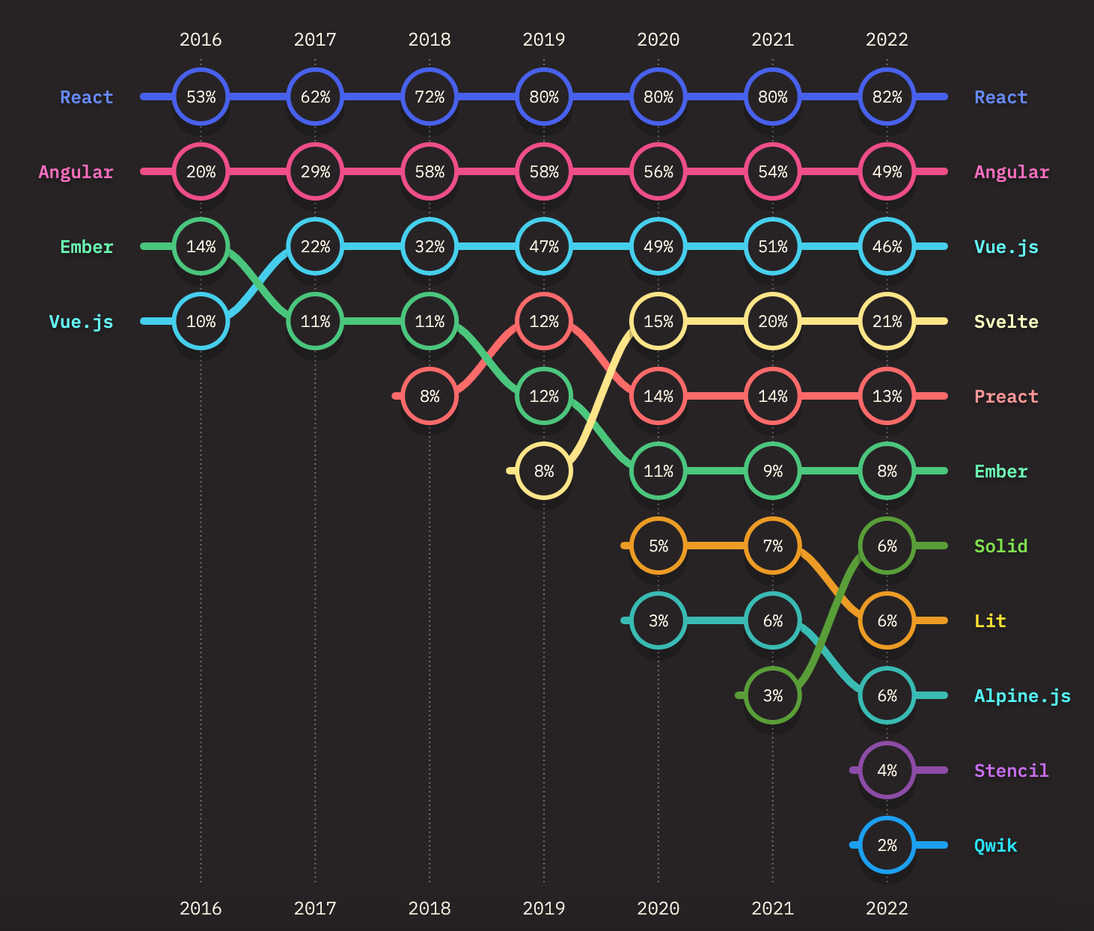
22-23 November 2024
https://2023.stateofjs.com/
Sofia, Bulgaria
https://www.jstalks.net/
Notes:
All of those frameworks have some similarity in the way they handle their process
They give you syntax that should increase maintainability

Slide 20
22-23 November 2024
WHEN THERE’S PRESSURE THERE’S PROGRESS
Sofia, Bulgaria
https://www.jstalks.net/

Slide 21
22-23 November 2024
FIRST MAKE THE CHANGE UNIDIRECTIONAL
Sofia, Bulgaria
https://www.jstalks.net/
Notes:
Remove mutations in your code
To remove them you’ll make new instances of objects (so immutability would be inferred)

Slide 22
22-23 November 2024
const newState = { … }
setState((prevState) => Object.assign(prevState, newState));
Sofia, Bulgaria
https://www.jstalks.net/
Notes:
i want to start off with a pitfall

Slide 23
22-23 November 2024
const newState = { … }
// Mutating state directly
setState((prevState) => Object.assign(prevState, newState));
Sofia, Bulgaria
https://www.jstalks.net/

Slide 24
22-23 November 2024
const newState = { … }
// Mutating state directly
setState((prevState) => Object.assign(prevState, newState));
// Correctly updating state
setState((prevState) => Object.assign({}, prevState, newState));
Sofia, Bulgaria
https://www.jstalks.net/
Notes:
we need to detect change to be reactive

Slide 25
22-23 November 2024
DETECT CHANGE
Sofia, Bulgaria
https://www.jstalks.net/
Notes:
Remove mutations in your code

Slide 26
22-23 November 2024
DETECT CHANGE
DETECT EMISSION
Sofia, Bulgaria
https://www.jstalks.net/

Slide 27
22-23 November 2024
RECAP
unidirectional data flow
produce emissions over time (mutation awareness)
Sofia, Bulgaria
https://www.jstalks.net/

Slide 28
22-23 November 2024
BUILD A RELATIONSHIP
Sofia, Bulgaria
https://www.jstalks.net/

Slide 29
22-23 November 2024
BUILD A RELATIONSHIP
┌───────────────┐ ┌───────────────┐
│ │ │ │
│ (A) │ ───────────────────> │ (B) │
│ │ │ │
└───────────────┘ └───────────────┘
Sofia, Bulgaria
https://www.jstalks.net/

Slide 30
22-23 November 2024
RECAP
unidirectional data flow
produce emissions over time (mutation awareness)
build a relationship
Sofia, Bulgaria
https://www.jstalks.net/

Slide 31
22-23 November 2024
IMPLEMENT REACTIVITY
Sofia, Bulgaria
https://www.jstalks.net/

Slide 32
22-23 November 2024
WE IMPLEMENTED REACTIVITY!
Sofia, Bulgaria
https://www.jstalks.net/

Slide 33
22-23 November 2024
DID WE?
Sofia, Bulgaria
https://www.jstalks.net/

Slide 34
22-23 November 2024
WHO OWNS THE ARROW?
┌───────────────┐ ┌───────────────┐
│ │ │ │
│ (appState) │ ───────────────────> │ (domUpdater) │
│ │ │ │
└───────────────┘ └───────────────┘
Sofia, Bulgaria
https://www.jstalks.net/

Slide 35
22-23 November 2024
// appState -> domUpdater
appState.onStateChange((state) => {
domUpdater.updateDOM(state);
});
Sofia, Bulgaria
https://www.jstalks.net/
Notes:
What are the problems of creating a relationship between memory and code
Has this created a relationship

Slide 36
22-23 November 2024
PASSIVE BEHAVIOR
Proactive Passive
┌───────────────┐ ┌───────────────┐
│ │ │ │
│ (appState) │───────────────────> │ (domUpdater) │
│ │ │ │
└───────────────┘ └───────────────┘
Sofia, Bulgaria
https://www.jstalks.net/

Slide 37
22-23 November 2024
REACTIVE BEHAVIOR
Listenable Reactive
┌───────────────┐ ┌───────────────┐
│ │ │ │
│ (appState) │ ───────────────────>│ (domUpdater) │
│ │ │ │
└───────────────┘ └───────────────┘
Sofia, Bulgaria
https://www.jstalks.net/
Notes:
What is the benefit of this approach?
It is Inversion of Control, mainly because domUpdater is responsible for itself. Plus, we can hide its update function as a private function.
In the passive case, it was required to have update function public, which means we are exposing domUpdater’s internal state management outwards.
It also means if we want to discover how DomUpdater works, we need to find all usages of the updateFn in the codebase

Slide 38
22-23 November 2024
REACTIVE BEHAVIOR
function domManager(appState) {
appState.onStateChange(updateDOM);
}
const appState = stateManager({ value: 'Hello' }, reducer);
const domUpdater = domManager(appState);
// No need to set up the subscription here anymore
// The domManager handles its own subscription internally
Sofia, Bulgaria
https://www.jstalks.net/

Slide 39
22-23 November 2024
RECAP
unidirectional data flow
produce emissions over time
mutation awareness
build a relationship
subscribe to changes
Sofia, Bulgaria
https://www.jstalks.net/
Notes:
Solved the problem of managing updates
Solution is kind of clunky as we are the source of updates
We can do better, right now we react to all events

Slide 40
22-23 November 2024
IS THERE A SINGLE DATA STRUCTURE THAT ENCOMPASSES ALL THESE PROPERTIES?
Sofia, Bulgaria
https://www.jstalks.net/
Notes:
Space and time to be captured in a const

Slide 41
22-23 November 2024
OBSERVABLES
Observables are lazy push collections of multiple values.
Sofia, Bulgaria
https://www.jstalks.net/
Notes:
Really powerful in composing and modifying producer behavior
We created an observer

Slide 42
22-23 November 2024
IMPLEMENTATION
class Observable<T> {
private _subscribe: SubscribeFn<T>;
constructor(subscribe: SubscribeFn<T>) {
this._subscribe = subscribe;
}
subscribe(observer: Observer<T>): Subscription {
return this._subscribe(observer);
}
}
Sofia, Bulgaria
https://www.jstalks.net/

Slide 43
22-23 November 2024
IMPLEMENTATION
type Observer<T> = {
next: (value: T) => void;
error?: (err: any) => void;
complete?: () => void;
};
Sofia, Bulgaria
https://www.jstalks.net/

Slide 44
22-23 November 2024
IMPLEMENTATION
type Observer<T> = {
next: (value: T) => void;
error?: (err: any) => void;
complete?: () => void;
};
type Subscription = {
unsubscribe: () => void;
}
type SubscribeFn<T> = (observer: Observer<T>) => Subscription;
Sofia, Bulgaria
https://www.jstalks.net/

Slide 45
22-23 November 2024
MORE CODE
Sofia, Bulgaria
https://www.jstalks.net/

Slide 46
22-23 November 2024
COMPOSITION OF SIDE EFFECTS
 | SINGULAR | PLURAL
SPATIAL | Value | Iterable<Value>
TEMPORAL | Promise<value> | Observable<Value>
Sofia, Bulgaria
https://www.jstalks.net/
Notes:
The border picture is that reactivity is managing side effects
What are side effect: side effects occur when a function or operation interacts with the outside world or modifies a state outside its local context:
Programming fundamentally involves dealing with side effects, whether synchronous or asynchronous, single or multiple values, and whether they are produced or consumed.
Everything is an observable
Reactive is just a marketing term for duality of covariance and contravariance
Reactive is composition of side effects

Slide 47
22-23 November 2024
DIMENSIONS
Sync / async
Single consumer / multiple consumers
Unicast / broadcast
Kris Kowal (GTOR)
Sofia, Bulgaria
https://www.jstalks.net/

Slide 48
22-23 November 2024
MANAGING SIDE EFFECTS
Producer
Consumer
Sofia, Bulgaria
https://www.jstalks.net/
Notes:
How do you create data when you have a single value
Generator and iterator

Slide 49
22-23 November 2024
REACTIVE AND PASSIVE
Push - vue, svelte
Pull - react
Sofia, Bulgaria
https://www.jstalks.net/
Notes:
Handling side effects really depends on the type of data that you’re working with

Slide 50
22-23 November 2024
HOW HAS THIS HELPED US
const observable = new Observable((subscriber) => { … });
function App() {
const [value, setValue] = useState(0);
useEffect(() => {
const subscription = observable.subscribe(setValue);
return () => subscription.unsubscribe();
}, []);
return <div>Random Value: {value}</div>;
}
Sofia, Bulgaria
https://www.jstalks.net/

Slide 51
22-23 November 2024
HOW HAS THIS HELPED US
const { middleware } = engineHost();
function App() {
const [value, setValue] = useState({});
useEffect(() => {
const unsubscribe = middleware.onChange(setValue);
return () => unsubscribe();
}, []);
return <PageContent value={value} />;
}
Sofia, Bulgaria
https://www.jstalks.net/
Notes:
Compare to the input example, which is pretty simple, when we have a lot of complex interactions that change the dom, if the alternative is imperative, we would never scale

Slide 52
22-23 November 2024
How can we design modern applications to be more predictable and maintainable?
Sofia, Bulgaria
https://www.jstalks.net/
Notes:
Giving a set of mental tools

Slide 53
jQuery(document).ready(function(){
/**
* This part handles the highlighting functionality.
*/
var aChildren = jQuery("aside.sub_cat_active ul li").children(); // find the a children of the list items
var aArray = []; // create the empty aArray
for (var i=0; i < aChildren.length; i++) {
var aChild = aChildren[i];
var ahref = jQuery(aChild).attr('href');
aArray.push(ahref);
} // this for loop fills the aArray with attribute href values
jQuery(window).scroll(function(e){
var windowPos = jQuery(window).scrollTop(); // get the offset of the window from the top of page
var windowHeight = jQuery(window).height(); // get the height of the window
var docHeight = jQuery(document).height();
for (var i=0; i < aArray.length; i++) {
var theID = aArray[i];
var divPos = jQuery(theID).offset().top + (-100); // get the offset of the div from the top of page
var divHeight = jQuery(theID).height(); // get the height of the div in question
if (windowPos >= divPos && windowPos < (divPos + divHeight)) {
jQuery("a[href='" + theID + "']").parent().addClass("aside-selected");
jQuery("a[href='" + theID + "']").addClass("selected-link");
if(isMobile.matches && window.location.href.indexOf(".php") > -1 ){
jQuery("body.subcat-page aside.sub_cat_active ul li .selected-link")[0].scrollIntoView( { inline: "center" } );
// jQuery("body.subcat-page aside.sub_cat_active ul li .selected-link")[0].scrollIntoView();
}
} else {
jQuery("a[href='" + theID + "']").parent().removeClass("aside-selected");
jQuery("a[href='" + theID + "']").removeClass("selected-link");
}
}
if(windowPos + windowHeight == docHeight) {
if (!jQuery("#v-nav ul li:last-child a").parent().hasClass("aside-selected")) {
var navActiveCurrent = jQuery(".aside-selected").children().attr("href");
jQuery("a[href='" + navActiveCurrent + "']").parent().removeClass("aside-selected");
jQuery("#v-nav ul li:last-child a").parent().addClass("aside-selected");
}
}
});
});
22-23 November 2024
Sofia, Bulgaria
https://www.jstalks.net/
Notes:
Тва като го видите какво си мислите
Ако го видите тоя код кво си викате

Slide 54
22-23 November 2024
const { fromEvent } = rxjs;
const { throttleTime, map, distinctUntilChanged, filter, tap, startWith } = rxjs.operators;
// ... (utility functions and initial setup)
const activeSectionSubscription = fromEvent(window, 'scroll').pipe(
throttleTime(100),
map(() => window.scrollY),
startWith(window.scrollY),
distinctUntilChanged(),
tap(scrollPos => {
const activeID = getActiveSection(scrollPos, sectionIDs);
const updates = prepareClassUpdates(activeID, navAnchors);
applyClassUpdates(updates, isMobile);
})
).subscribe();
const bottomSubscription = fromEvent(window, 'scroll').pipe(
throttleTime(100),
map(() => (window.scrollY + window.innerHeight) >= (document.body.scrollHeight - 1)),
distinctUntilChanged(),
filter(isBottom => isBottom),
tap(() => highlightLastNavItem(navAnchors))
).subscribe();
Sofia, Bulgaria
https://www.jstalks.net/

Slide 55

22-23 November 2024
adaasdlkajdlksassadsa
Sofia, Bulgaria
https://www.jstalks.net/
Notes:
Not here to preach, simple code does the job

Slide 56
22-23 November 2024
SUCCINCTNESS IS POWER
Sofia, Bulgaria
https://www.jstalks.net/
Notes:
There’s always a turning point when maintenance becomes hell
So we should consider the less verbose approach that does the most work

Slide 57

Notes:
Botev plovdiv s botev vraca ne ?
Define a clear goal of the presentation and what is going to be explained
In the beginning describe what it’s about and in the end put it into focus
Thread throughout the presentation of a takeaway
Elaboration on everyday principles (black box opening)
More diagrams
Summary of the concepts (recap)
Resolution of the concept provided in the beginning
Elaborate on push pull behaviors
You create a mental model but it’s shielded by the framework you’re using
Provide partial answer of the main question we’re answering throughout the presentation

Slide 58
22-23 November 2024
Pop culture is all about identity and feeling like you're participating. It has nothing to do with cooperation, the past or the future — it's living in the present. I think the same is true of most people who write code for money.
Alan Kay
Sofia, Bulgaria
https://www.jstalks.net/
Notes:
Why did I start working with react
React before understanding js (inspiration)
Along the way found how the industry is converging
Reactivity as pop culture

Slide 59
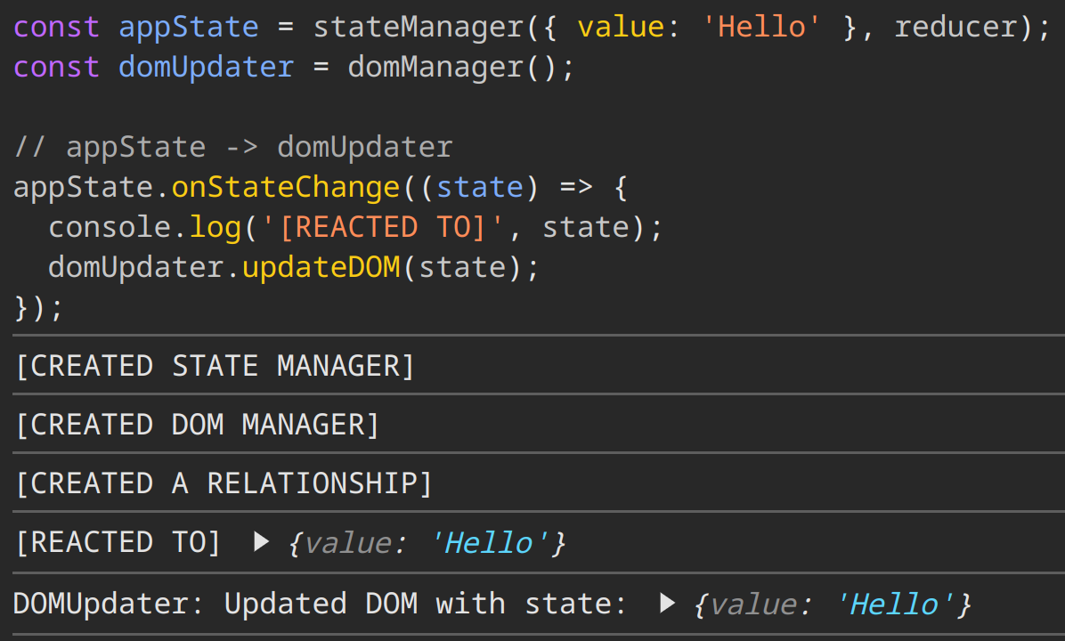
22-23 November 2024
Sofia, Bulgaria
https://www.jstalks.net/

Slide 60
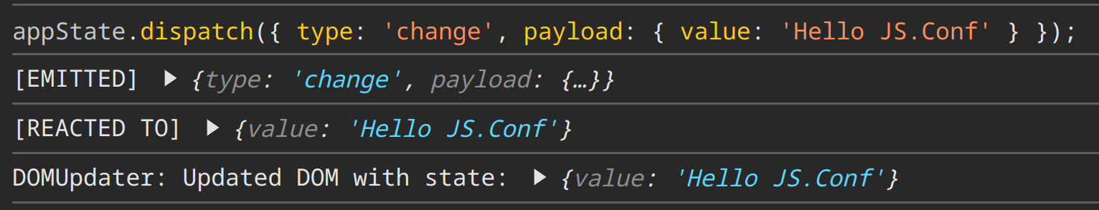
22-23 November 2024
Sofia, Bulgaria
https://www.jstalks.net/

Slide 61
22-23 November 2024
const inputObservable = createObservable(inputElement, 'input')
.pipe(
map(event => event.target.value),
debounce(500)
);
Sofia, Bulgaria
https://www.jstalks.net/

Slide 62
22-23 November 2024
HOW DO WE MANAGE MEMORY?
const data = { value: 'Hello' };
const content = document.createTextNode(data.value);
const paragraph = document.createElement('p');
paragraph.appendChild(content);
document.body.appendChild(paragraph);
Sofia, Bulgaria
https://www.jstalks.net/
Notes:
What are the problems of creating a relationship between memory and code
Has this created a relationship

Slide 63
22-23 November 2024
HOW DO WE MANAGE MEMORY?
const data = { value: 'Hello' };
const content = document.createTextNode(data.value);
const paragraph = document.createElement('p');
paragraph.appendChild(content);
document.body.appendChild(paragraph);
// after some time
data.value = 'Hello JS.Talks()';
Sofia, Bulgaria
https://www.jstalks.net/
Notes:
You need a specific emission in time
Moving against the flow of execution
Toq mutation poveche emphasiz

Slide 64
22-23 November 2024
VALUE ORIENTED DESIGN
Are we building systems that are truly about information, or are they mainly about manipulating space?
Rich Hickey
Sofia, Bulgaria
https://www.jstalks.net/
Notes:
We mutated space, optimized for the cheapest resource

